Slide 1
Marketplace Design & User Story
2020.6.2

Slide 2
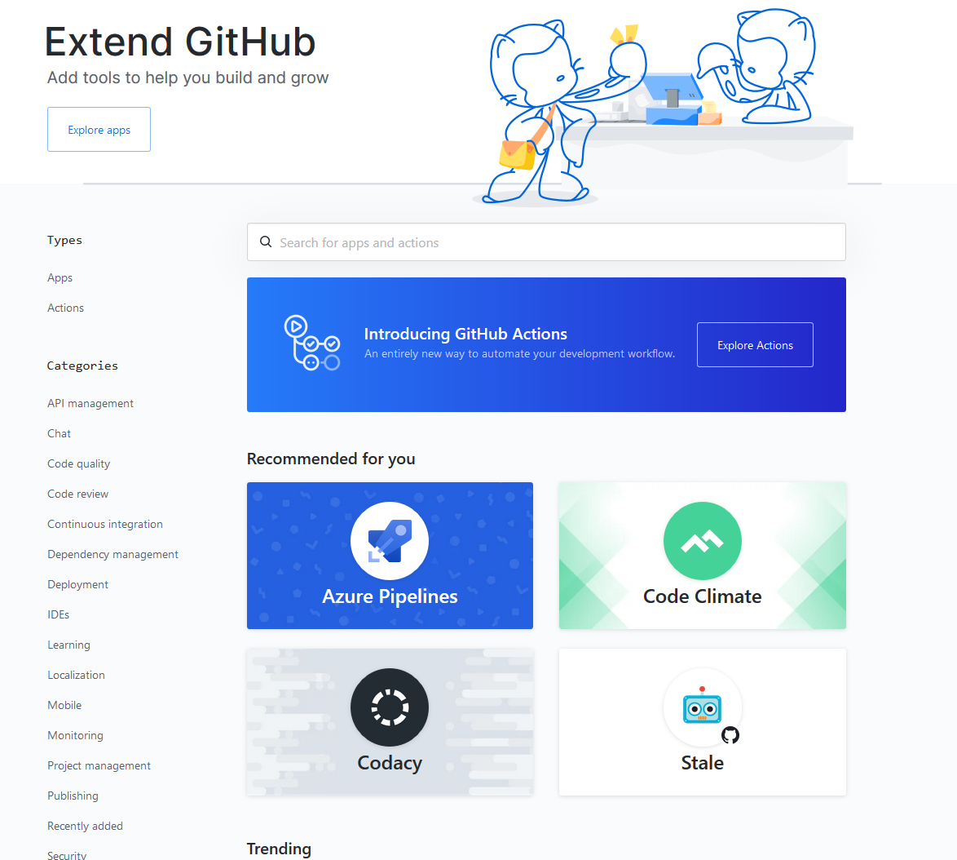
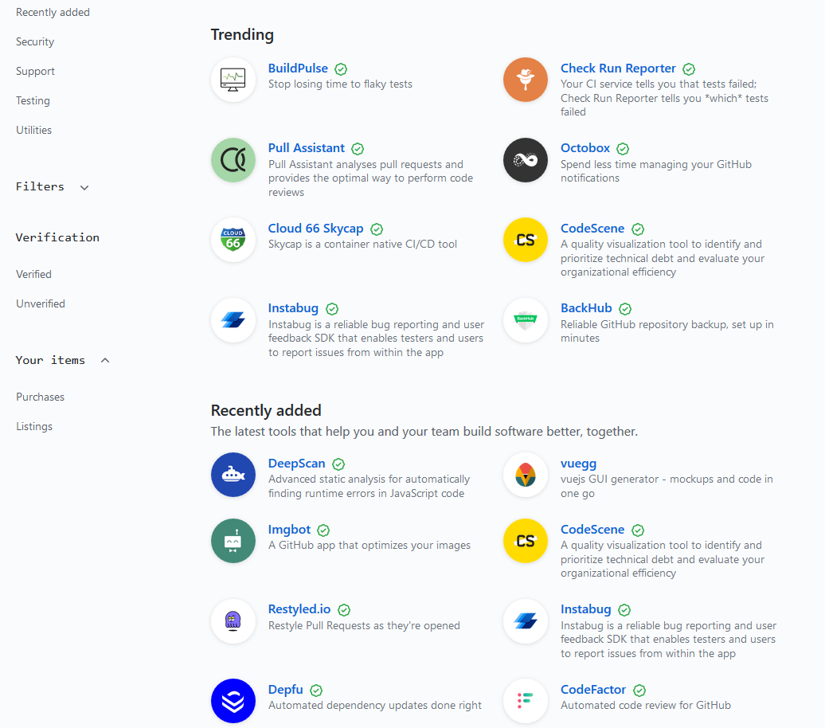
Reference – Github Marketplace
Types
Categories
Recommend
Trending
Recent
Notes:
Validate each module config with corresponding schema
Validate globalConfig with all schemas.
Validate each dependency module config with all corresponding schemas.
Allow default value
Only submodule appears in config will be processed

Slide 3
Types
Data
lower bound: share folder + remote link
upper bound: cloud storage service (access control, visualization, management (crud & version control), user)
Utilize user provide third party storage
Model
code or model file
Image
docker environment
Job
Image + Model + Data + Resource (platform related config)
Tutorial
Contest
Notes:
Validate each module config with corresponding schema
Validate globalConfig with all schemas.
Validate each dependency module config with all corresponding schemas.
Allow default value
Only submodule appears in config will be processed

Slide 4
Types - Data
Summary
Description
Data Explorer (postpone)
How to use ?
use Dshuttle or azure storage or direct link as interface to load into pai job
directly used in cluster, available in which cluster
Admin set storage in advance, marketplace directly use it. User upload it.
Openpai teamwise storage.
Public storage. Provide interface (download in advance).
Provide a snnipet
Provide a reference: copy & paste
Notes:
Validate each module config with corresponding schema
Validate globalConfig with all schemas.
Validate each dependency module config with all corresponding schemas.
Allow default value
Only submodule appears in config will be processed

Slide 5
Types - Model
In model training scenario, debug mod is needed to fine tune the parameters
Better suitable for a fixed model
Notes:
Validate each module config with corresponding schema
Validate globalConfig with all schemas.
Validate each dependency module config with all corresponding schemas.
Allow default value
Only submodule appears in config will be processed

Slide 6
Types - Image
Predefined environment image
Summary
Description
Dockerfile
( Autogeneration)
Notes:
Validate each module config with corresponding schema
Validate globalConfig with all schemas.
Validate each dependency module config with all corresponding schemas.
Allow default value
Only submodule appears in config will be processed

Slide 7
Types - Job
Data
Model
Image
Resources (platform config)
Notes:
Validate each module config with corresponding schema
Validate globalConfig with all schemas.
Validate each dependency module config with all corresponding schemas.
Allow default value
Only submodule appears in config will be processed

Slide 8
Types – Tutorial (TBD)
Pdf file
Jupyter notebook support
Notes:
Validate each module config with corresponding schema
Validate globalConfig with all schemas.
Validate each dependency module config with all corresponding schemas.
Allow default value
Only submodule appears in config will be processed

Slide 9
Types – Contest (TBD)
Dataset
Validation
Result dashboard
Notes:
Validate each module config with corresponding schema
Validate globalConfig with all schemas.
Validate each dependency module config with all corresponding schemas.
Allow default value
Only submodule appears in config will be processed

Slide 10
User story – COVID 19 (Qiwei)
Data: dynamic change, share folder
Model: production model
Put various COVID 19 datasets in data section as different components
Researchers could save their model (code folder, git link, model file) in model section to share
Docker image for training and inference
Use a Job (platform)
Notes:
Validate each module config with corresponding schema
Validate globalConfig with all schemas.
Validate each dependency module config with all corresponding schemas.
Allow default value
Only submodule appears in config will be processed

Slide 11
User story – Yidian(yuqing)
Job Clone: template, result validation, dashboard
10 experiments (topic)
Favorite
Like Kaggle contest
Multi cluster support ( type job template)
Diff from inter-cluster clone
Notes:
Validate each module config with corresponding schema
Validate globalConfig with all schemas.
Validate each dependency module config with all corresponding schemas.
Allow default value
Only submodule appears in config will be processed

Slide 12
Discussion
Frontend UI: Embedded or Standalone
Issues if embedded:
Using pai auth and user management
Multi platform support
Notes:
Validate each module config with corresponding schema
Validate globalConfig with all schemas.
Validate each dependency module config with all corresponding schemas.
Allow default value
Only submodule appears in config will be processed

Slide 13
Work Items
Data: unified data storage – easy upload + easy access + ui + easy utilized by platform
Model: scenario test
Docker:
Job: example
Notes:
Validate each module config with corresponding schema
Validate globalConfig with all schemas.
Validate each dependency module config with all corresponding schemas.
Allow default value
Only submodule appears in config will be processed

Slide 14
Ideas & requirements
Inside one openpai cluster marketplace ( user & team )
Notes:
Validate each module config with corresponding schema
Validate globalConfig with all schemas.
Validate each dependency module config with all corresponding schemas.
Allow default value
Only submodule appears in config will be processed

